Slide 1
Supporting Emergency Room Decision-Making with Relevant Scientific Literature
Rohan Shetty, Liam Spurr, Didugu Sutej, and Mrigank Tiwari

Slide 2
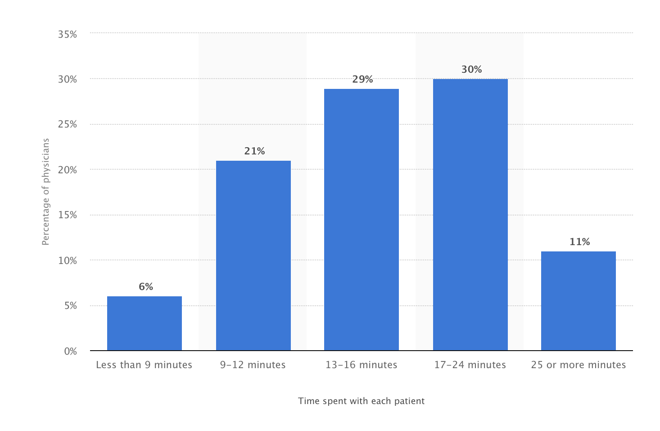
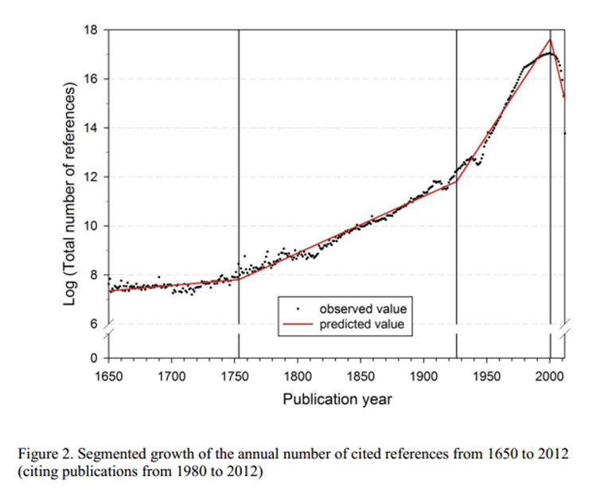
Motivation and problem statement
To provide health care providers (HCPs) with automated access to articles that can support clinical decision-making and diagnosis.
Each patient represents a new combination of history, symptoms, and potential disease.
HCPs are already overloaded and often have trouble keeping up with the latest literature about treatments, diseases, and the interactions between them.
Our plan is to develop a tool which can be used to provide HCPs with rapid and accurate reports of research relevant to each patient who enters the hospital.
Sources: statista.com (above), nature.com (below)

Slide 3
Problem statement continued
There is currently no readily-available software that will link Electronic Health Records to relevant scientific articles. While there are existing tools which summarize articles and extract keywords, it does not have the capability to combine these with medical terminology to identify clinically relevant information.
Our approach will identify actionable keywords in ER summaries and use these tokens to identify articles that can provide support in clinical decision making by delivering articles that provide information relevant to a patient’s condition.

Slide 4
Overview
Develop working medical ontology
Start with MeSH Ontology
Shrink to ~50K words
Extract clinical summaries
Extract keywords from summaries
Remove stopwords
Identify keywords present in the ontology
Lookup articles
Find articles containing the keywords
Score based on number of keywords present
Summarize articles
Examine performance

Slide 5
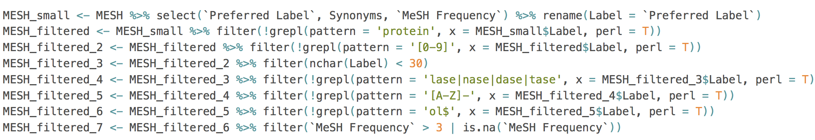
Optimizing a medical ontology
Started with the MeSH ontology (.csv version) by the National Library of Medicine (needed a shallow ontology) https://bioportal.bioontology.org/ontologies/MESH/?p=summary
Used simple filtering commands and regular expressions in R
Sequentially filtered out unwanted entries until the ontology was the desired size
We focused on conditions, medications, symptoms and the like— filtered out chemical compounds, molecules, etc

Slide 6
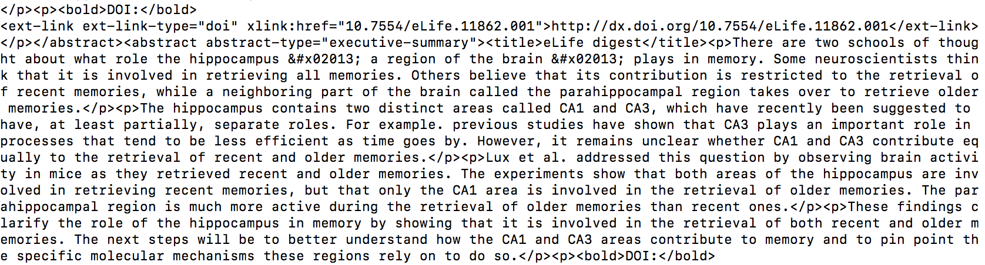
Preparing our data
ER Summaries
“...admission notes from MIMIC-III...describes a patient's chief complaint, relevant medical history, and any other information obtained during the first few hours of a patient's hospital stay, such as lab work… focuses on ICU … patients… actual data generated by clinicians... contain a significant number of abbreviations as well as other linguistic jargon and style
Required removal of tags and extraction of specific summaries (using regex)
Example: A 65-year-old male presents with dyspnea, tachypnea, chest pain on inspiration, and swelling and pain in the right calf.
PubMed Articles
“The target document collection for the track is the Open Access Subset of PubMed Central (PMC)... online digital database of freely available full-text biomedical literature… 1.25 million articles… full text of each article in the open access subset is represented as an NXML file”
Need to have tags and other formatting information removed to facilitate lookup and summarization.

Slide 7
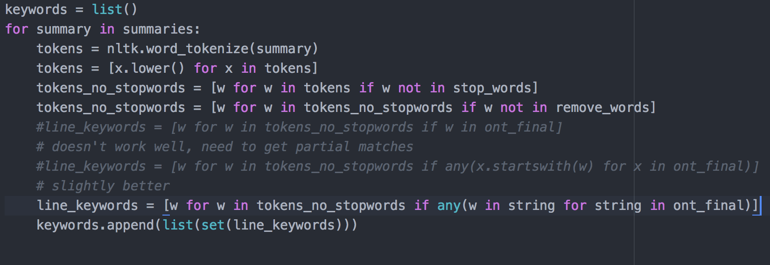
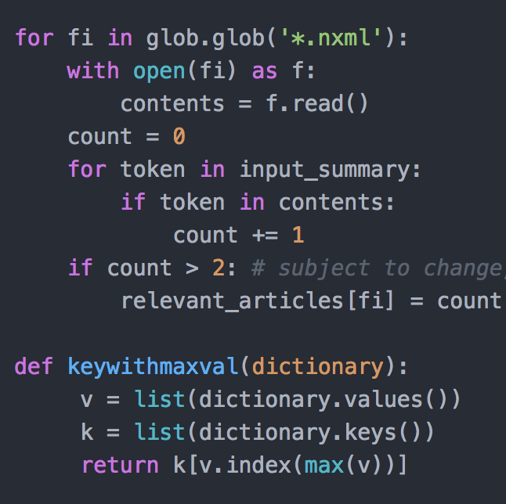
Article lookup
Part 1: Identify keywords
Removing stop words, common words, etc
Extracting only words from ontology
Part 2: Lookup the most relevant articles from the database
Note: # of articles
Different scoring approaches: unique words vs overall count
Notes:
Challenge: Number of articles to use (speed vs performance)

Slide 8
Text summarization
Extractive text summarization involves the selection of phrases and sentences from the source document to make up the new summary.
Ranking the relevance of phrases. (Gensim - python library / unsupervised)
Abstractive text summarization involves generating entirely new phrases and sentences to capture the meaning of the source document.
Kind of approach taken by humans.
This approach suits supervised methods where the algorithm has previous knowledge of the subject

Slide 9
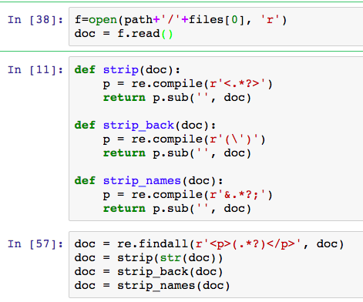
Text Extraction
Regex and ‘xmltodict’ library used to extract text from article XML files.
Notes:
First regex is used to select the text between paragraph tags, sec regex is used to remove random \ that occurred in the text, 3 rd regex is used to remove title tags and text formatting tags, 4th regex is used to remove special characters that were present in between the names of authors.

Slide 10
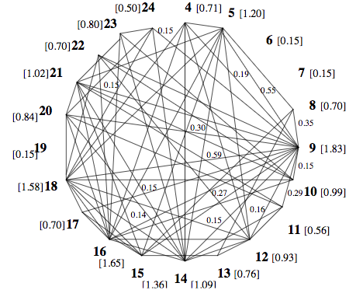
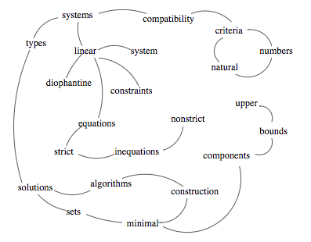
Working
‘Text Rank’ algorithm using Gensim library to summarize.

Slide 11
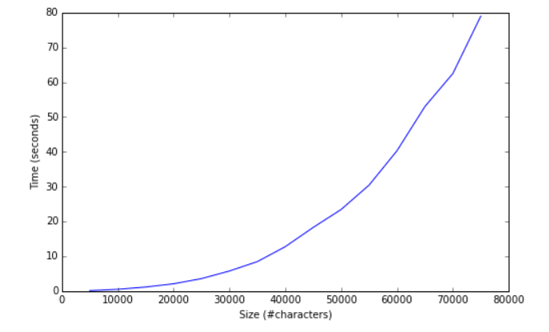
Performance
The data structure used in the algorithm is a graph which consists of nodes (sentences), where the weighted edges between the nodes shows how the sentences are related to each other
Thus, every piece of text will form a different graph thus having different running time.
As the size of the input dataset increases, the time taken by the algorithm also increases: in most cases it is polynomial time
Source: https://rare-technologies.com/text-summarization-with-gensim/

Slide 12
Drawback
Does not support multithreading.
Can be slow if in worst case size of graph is quadratic.
Currently only works for English datasets.

Slide 13
Example 1
How could we improve performance?
More articles
Stemming/lemmatization (problem: we don’t have a dictionary)
Implement a machine learning algorithms (problem: most require gold/labeled data, can be time-consuming)
Do you have any ideas?
Original ER Summary: A 62-year-old immunosuppressed male with fever, cough and intranuclear inclusion bodies in bronchoalveolar lavage.
Keywords to look up: ['bronchoalveolar', 'fever', 'cough', 'lavage', 'bodies', 'inclusion', 'intranuclear']
Note what’s missing: Immunosuppressed-- not in ontology, but immunosuppression is
Except from related article summary (6 keywords found):
Immunocompromised individuals including cancer patients, transplant recipients, and those receiving immunosuppressive therapies including monoclonal antibodies should be evaluated regularly and treated for LTBI at the time of diagnosis or just before starting immunosuppressive treatment (1, 6)., Several risk factors predispose individuals to M. To prevent reactivation of LTBI in recipients of allogeneic HSCT, it is recommended to consider administration of isoniazid (INH) prior to and post-HSCT particularly in patients living in areas that are endemic for TB (14)., M. tuberculosis infections in HSCT recipients should be based on: clinical grounds, sputum microscopy and cultures, cultures of pleural and pericardial fluid in addition to bronchoalveolar lavage (BAL) samples, bone marrow cultures, serology, molecular testing, and tissue biopsies (1, 40).
Select keywords: tuberculosis infections, infection, patient, therapy, immunosuppressive therapies, drug resistant, disease, sputum, cultures, pulmonary, rapidly progressive

Slide 14
Example 2
Original ER Summary: A 65-year-old male presents with dyspnea, tachypnea, chest pain on inspiration, and swelling and pain in the right calf.
Keywords to look up: ['right', 'dyspnea', 'pain', 'calf', 'tachypnea', 'chest', 'swelling']
Except from related article summary (6 keywords found):
Tamponade can cause hypotension due to decreased stroke volume, jugular-venous distension due to impaired venous return to the heart, and muffled heart tones due to fluid inside the pericardium. The patient did not have visibly distended neck veins, illustrating that these findings, known as Beck’s triad, are unreliable for the diagnosis of pericardial tamponade as it is seen only in a minority of patients. Dyspnea is the most common presenting finding with cardiac tamponade. Although this patient presented with normal blood pressure, it increased substantially to the patient\s baseline hypertensive state after pericardiocentesis. Dialysis treatments prevented recurrences of cardiac tamponade.
Select keywords: pulmonary, venous, blood, heart, dialysis, tamponade, albuterol, hypertensive, acute, passive, ventricular failure

Slide 15
Future work
Improve matching: perhaps try both matching based on unique words and total word matches and compare lists
Use of synonyms in the ontology
Match part of keyword (stemming/lemmatization?)
Try additional summarization approaches & compare performance

